Slide 1
Shakespeare!
What’s the big deal!?

Slide 2
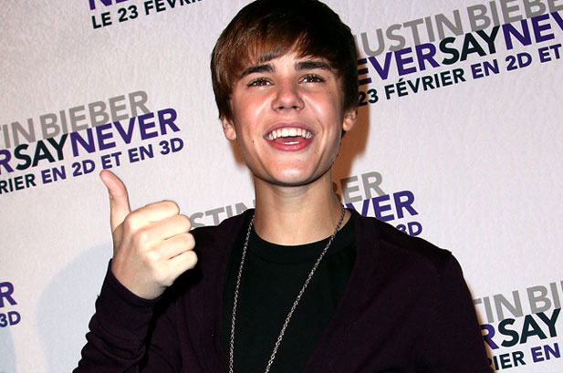
Nothing Better To Do?

Slide 3
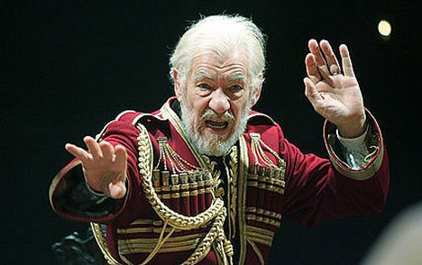
Entertaining?
“Fencing, fighting, torture, revenge, giants, monsters, chases, escapes, true love, miracles...”
← And it’s Gandalf!

Slide 4
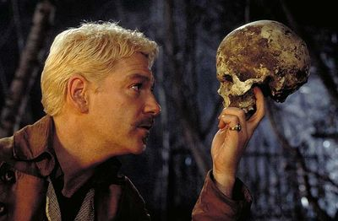

Slide 5
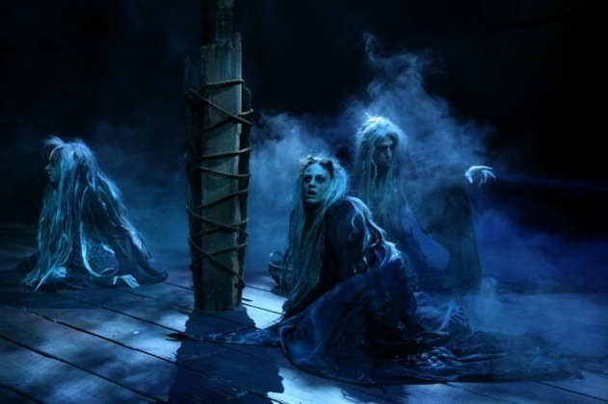

Slide 6
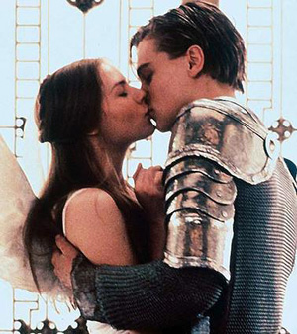

Slide 7
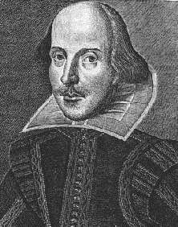
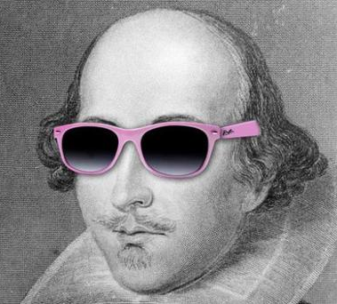
Timeless?
1564
2012

Slide 8
We Are Still Learning From Him?

Slide 9
“This above all, to thine own self be true.”
Hamlet 1.3

